Slide 1
Advance Computing Engine
CS222 – Computer Organization and Assembly Language
Supervisor:
Dr. Ghulam Abbas
Teacher Assistant:
Ms. Sherbano
Group Members:
Ahad Lodhi – 2020042
Mohsin Zia – 2020244
Syed Irtaza – 2020474
Zartaj Asim – 2020526

Slide 2
Contents
Arithmetic, Logic (and Shift) Unit
Instruction Format
Main Memory
Control Unit
Complete Computer Description
Simulator C++

Slide 3
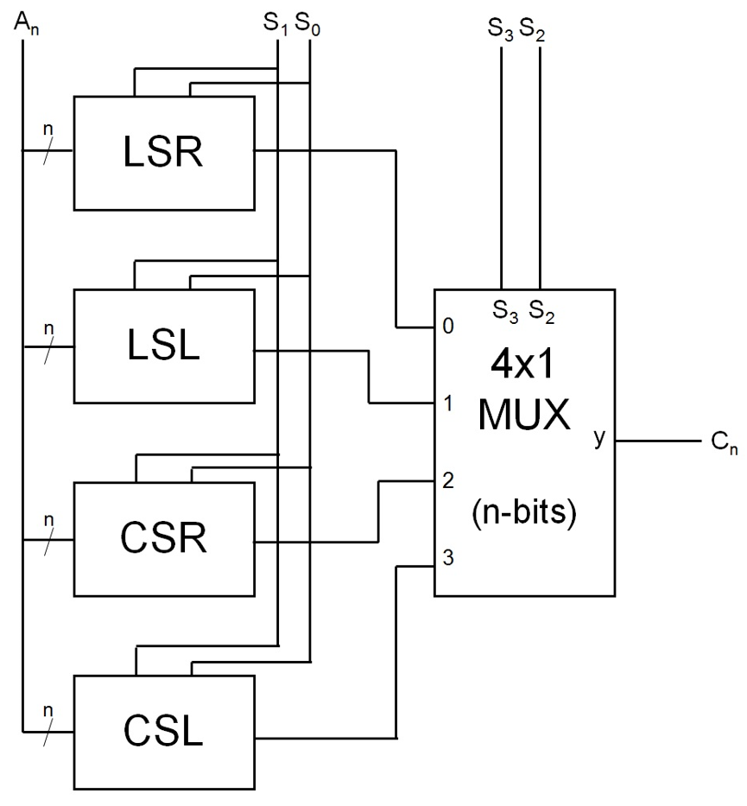
Shift Unit

Slide 4
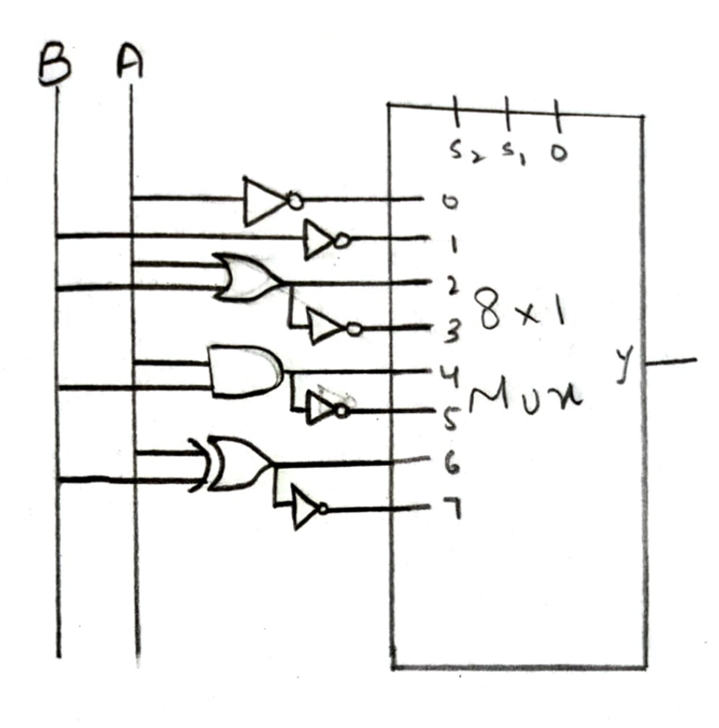
Logic Unit

Slide 5
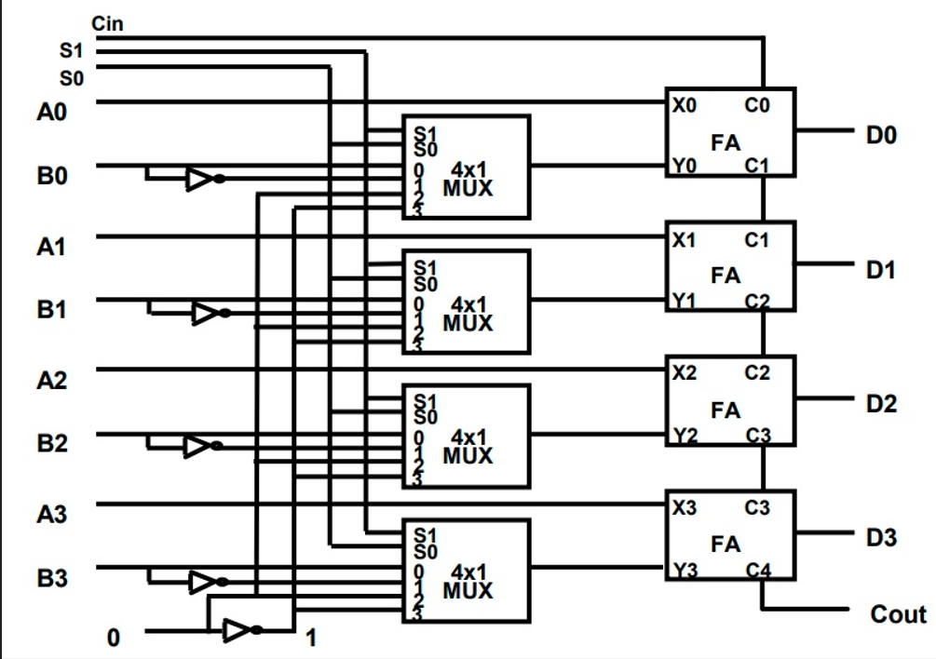
Arithmetic Unit

Slide 6
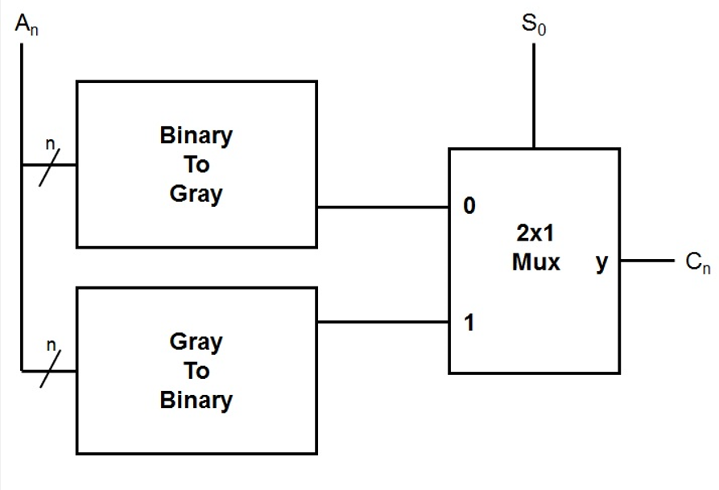
Binary – Gray Conversion Unit

Slide 7
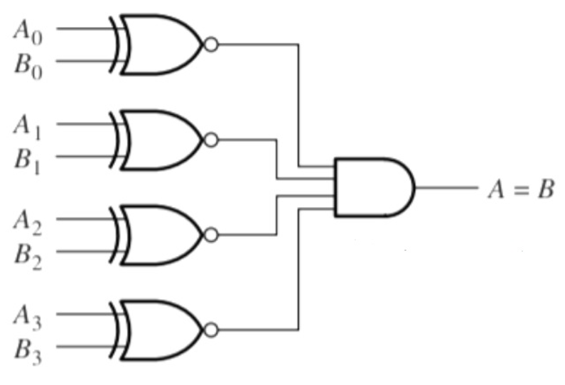
Equality Checker Unit

Slide 8
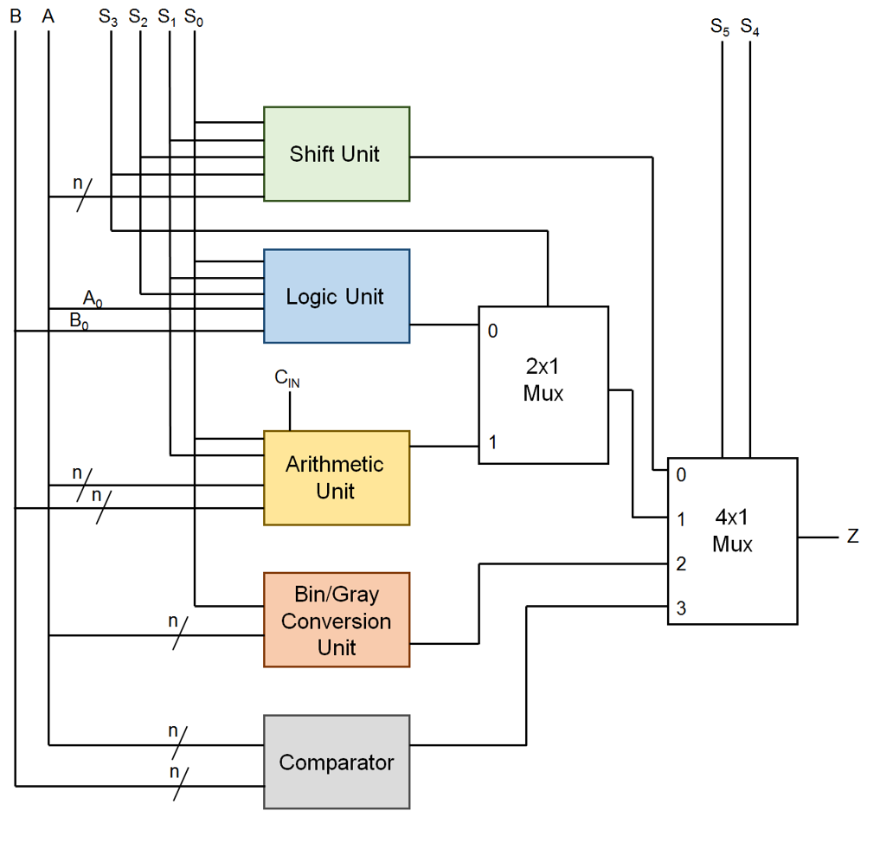
ALU

Slide 9
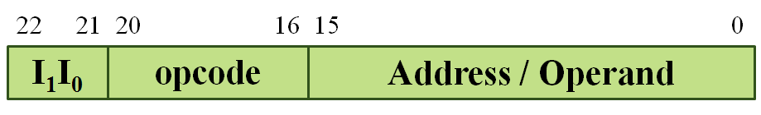
Instruction Format
2 Bits Addressing Mode
5 Bits Operation Code
16 Bits Address / Operand
Total Bits are 23

Slide 10
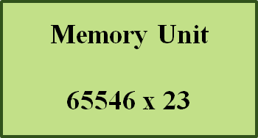
Main Memory
2^16 = 65536 blocks in Memory
Each block is 23 Bits long
Main Memory Unit (RAM) 65536 x 23

Slide 11
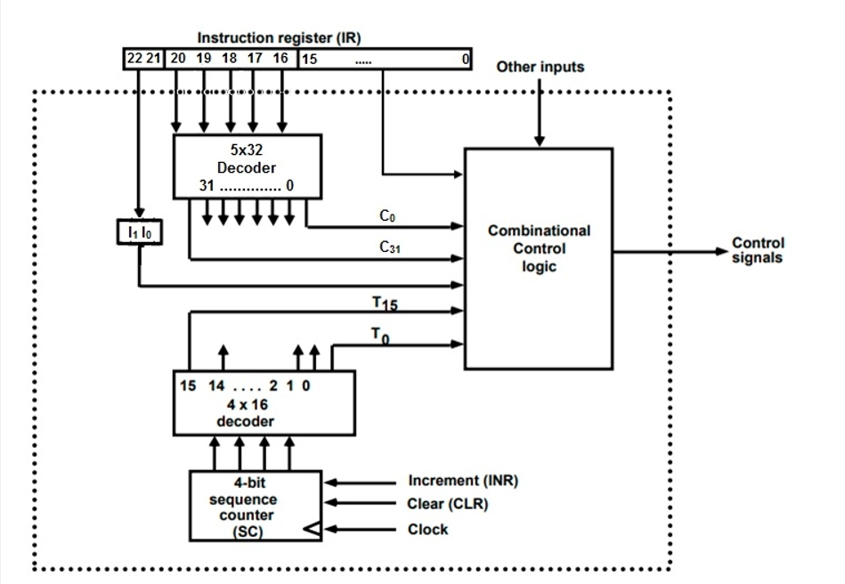
Control Unit

Slide 12
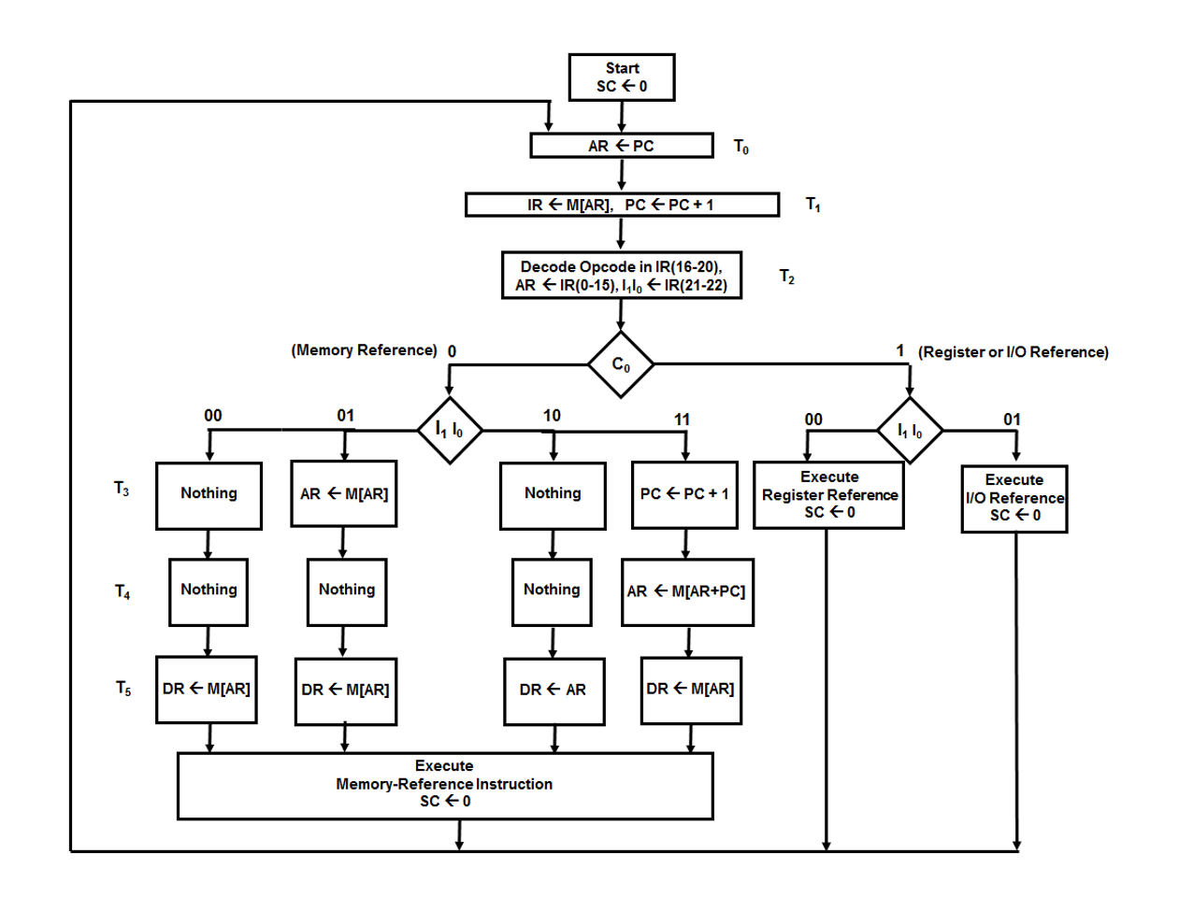
Fetch-Decode
Cycle

Slide 13
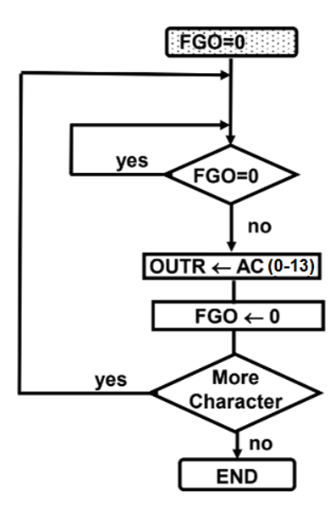
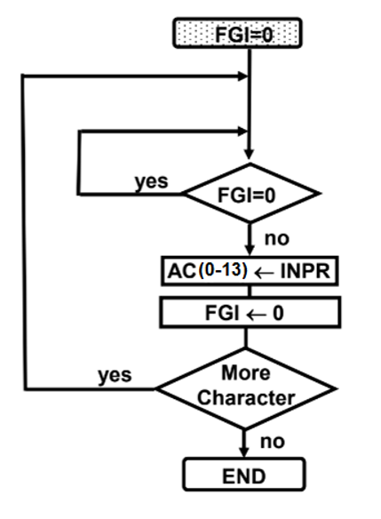
Input, Output

Slide 14
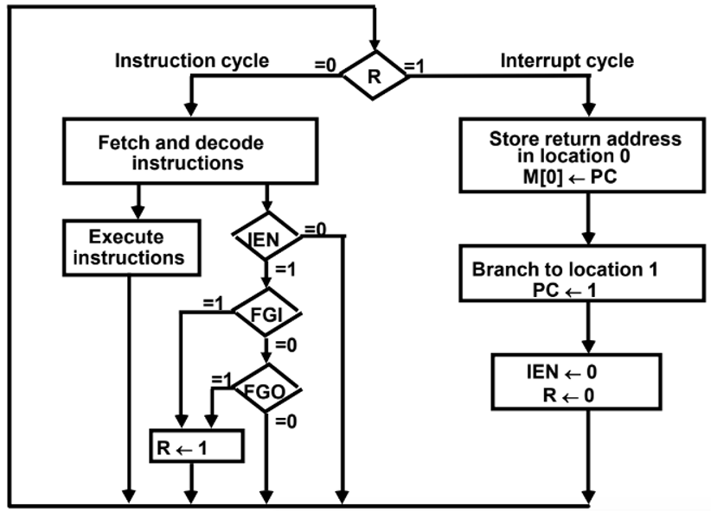
Interrupt

Slide 15
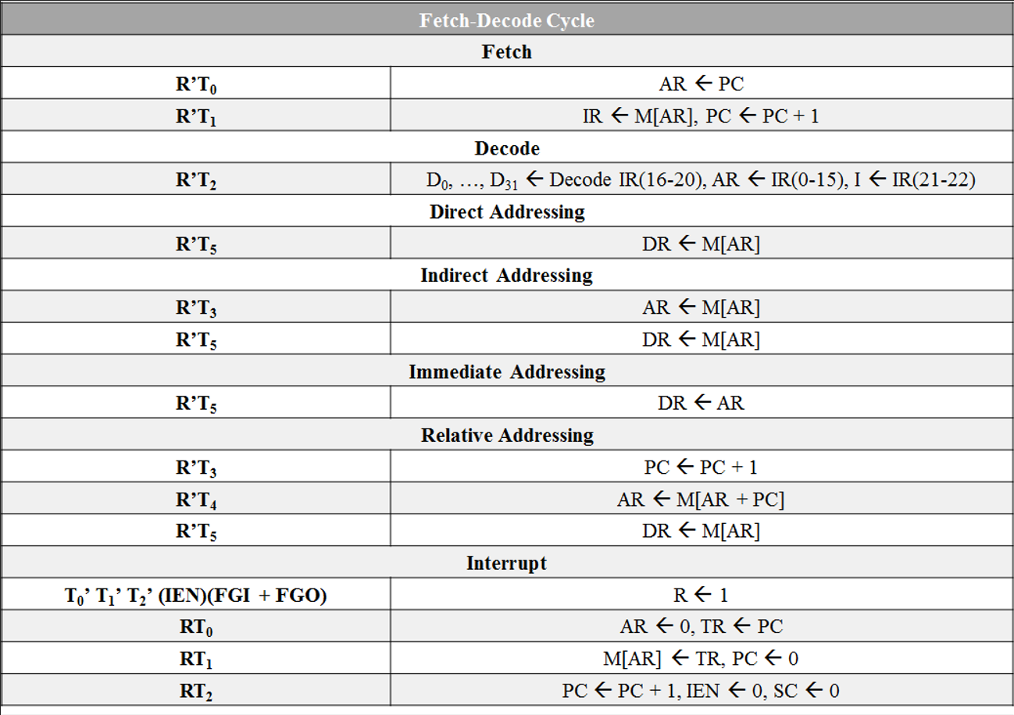

Slide 16
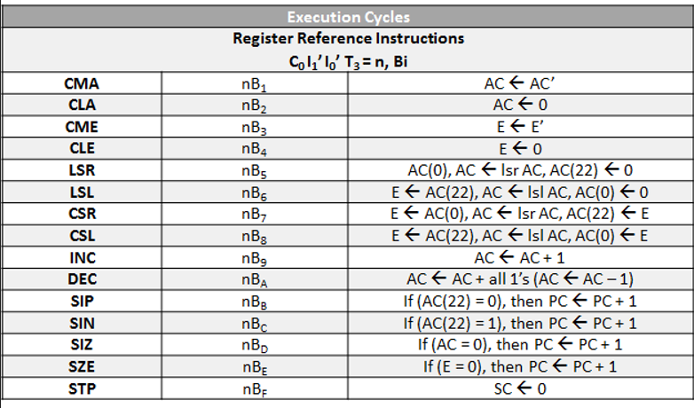

Slide 17
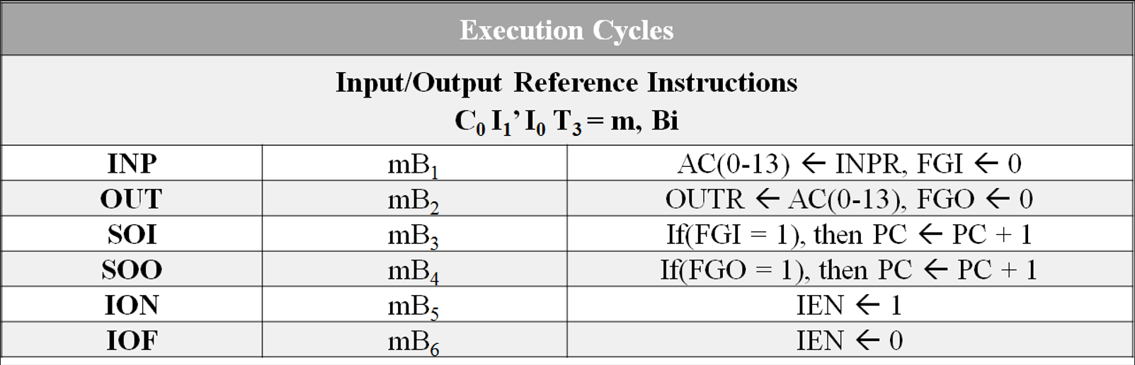

Slide 18
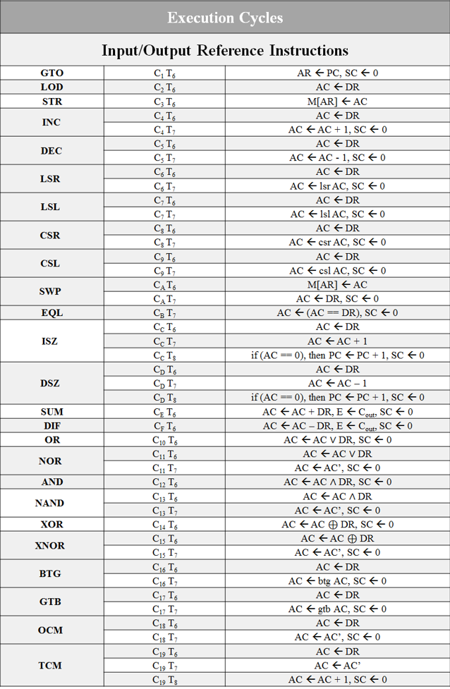

Slide 20
C++ Simulator

Slide 21
Thank You!

